Slide 1
Predicting Dialysis Center
Star Ratings
Nichole Hartz
Capstone 2
Notes:
All patients with end-stage kidney failure require dialysis but up to this point CRIC has not included dialysis information in their patient demographics.
In this preliminary study, we take the first step in identifying how dialysis centers affect patient health.

Slide 2
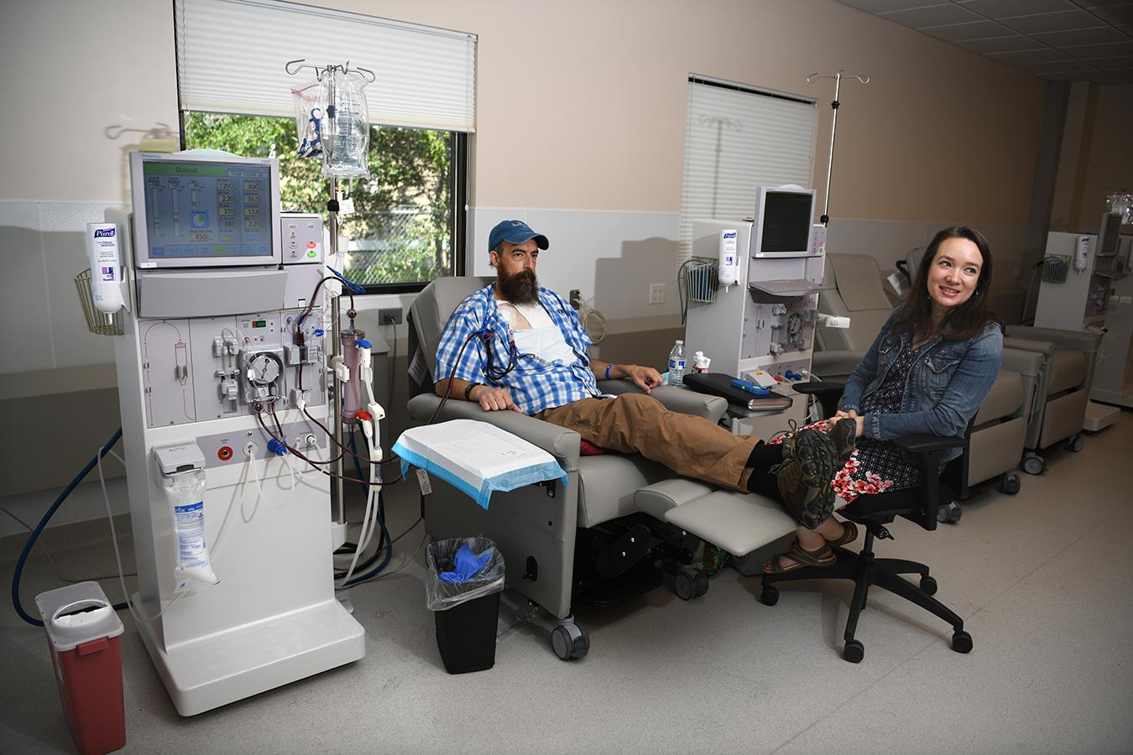
Dialysis
Needed in end stage kidney failure
Performed in various settings
Profit or Non-Profit
Some chains
Notes:
Dialysis is a treatment that acts as healthy kidneys and is needed in end stage kidney failure- 85 to 90% loss of kidney function. Kidneys keep the body in balance by removing waste, salt and extra water; keep a safe level of certain chemicals in your blood; and help to control blood pressure. Dialysis can be done in a hospital, in a dialysis center or at home.
Centers can be for profit or non-profits and some are chains.

Slide 3
How does an individual’s choice in dialysis center affect one’s kidney health?
How do dialysis centers differentiate from one another?
The Problem
Notes:
CRIC is curious to know how an individual’s choice in dialysis center affects one’s kidney health.
However, before we can answer that question we must first discover how dialysis centers differentiate

Slide 4

Data Information
Publisher: CMS
Time period: 01/01/2019 - 12/31/2019
Facilities: All registered with Medicare
Number of dialysis centers: 7724
Number of features: 119
File format: csv
Notes:
https://data.cms.gov/provider-data/dataset/23ew-n7w9
Data is provided by the centers for medicare and medicaid services
Data from 2019
Lists all the facilities registered with Medicare
Which is 7724 centers
With 119 features though many were not used due to missing values

Slide 5
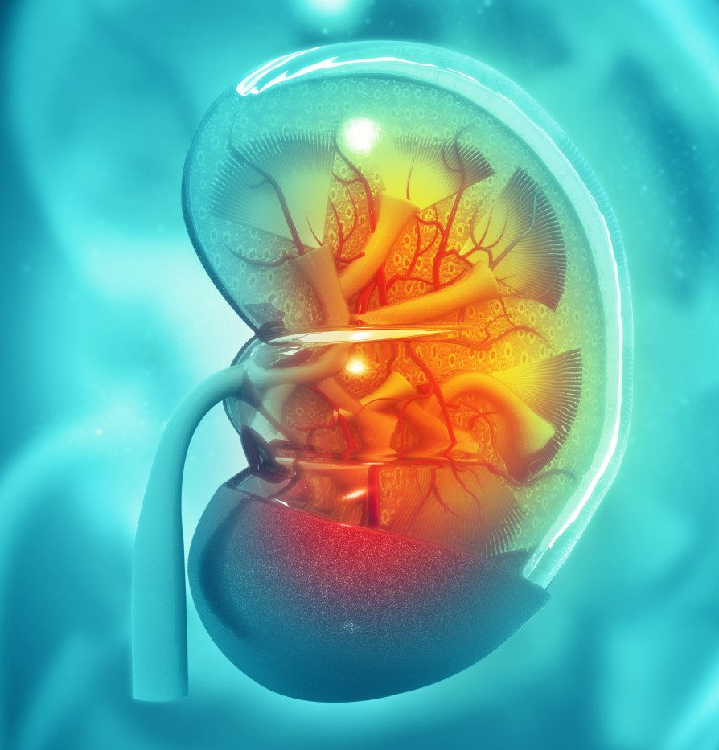
Dialysis Facility Compare Star Program
Mortality ratios
Hospitalizations
Blood transfusions
Incidents of hypercalcemia
Percent waste removed
Hemodialysis
Peritoneal dialysis
Percentage AV fistulas
Percentage catheters (> 90 days)
Notes:
One way we can compare dialysis centers is using the Dialysis Facility Compare Star Program
The Dialysis Facility Compare Star Program is a rating system developed by Medicare that assigns 1 to 5 stars to dialysis facilities by comparing the health of the patients in their clinics to the patients in other dialysis facilities.
The rating system in based on nine separate health statistics: mortality ratios (deaths), hospitalizations, blood transfusions, incidents of hypercalcemia (too much calcium in the blood), percentage of waste removed during hemodialysis in adults and children, percentage of waste removed in adults during peritoneal dialysis, percentage of AV fistulas, and percentage of catheters in use over 90 days.
Will use data from Dialysis Facility Compare Dataset from Data.Medicare.gov

Slide 6
Data Exploration
Health statistics & star rating
Between health statistics
Other feature to note
Notes:
Data exploration shows three different types of interactions
The interactions between health statistics and star rating
Interactions between health statistics
And interactions between other features not used in the model

Slide 7
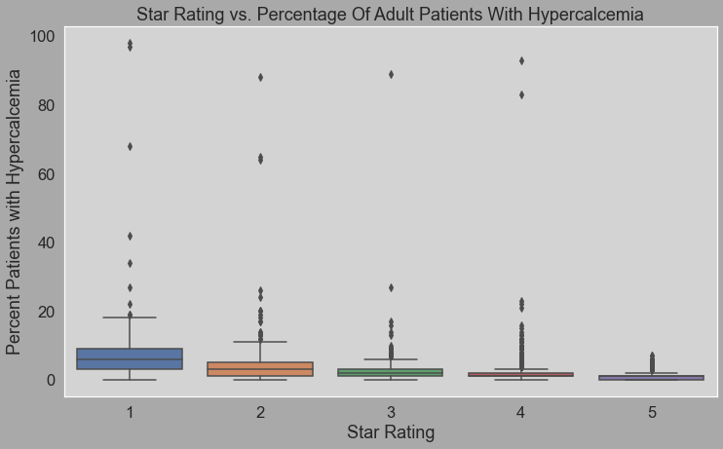
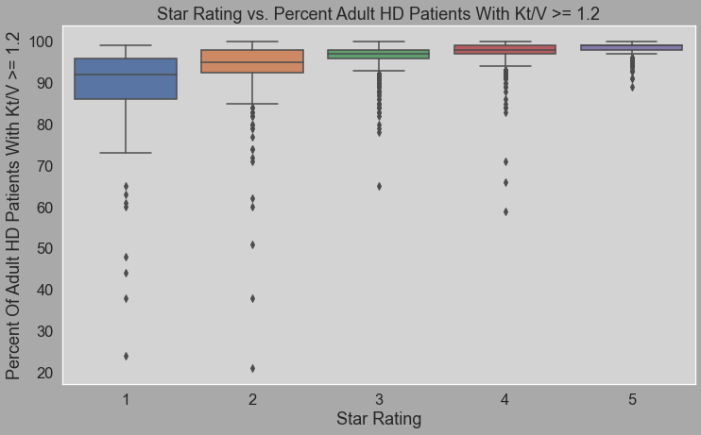
Blood measures of dialysis adequacy
Smaller range for higher ratings
Notes:
To get five star rating need very low hypercalcemia and very high percentage of Kt/V >= 1.2
Wide ranges for lower star ratings indicating can get score needed for one five star in one feature but need other features to score well also

Slide 8
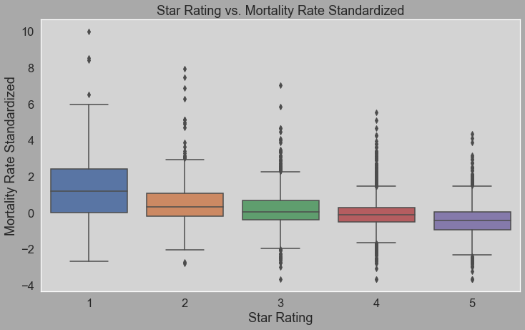
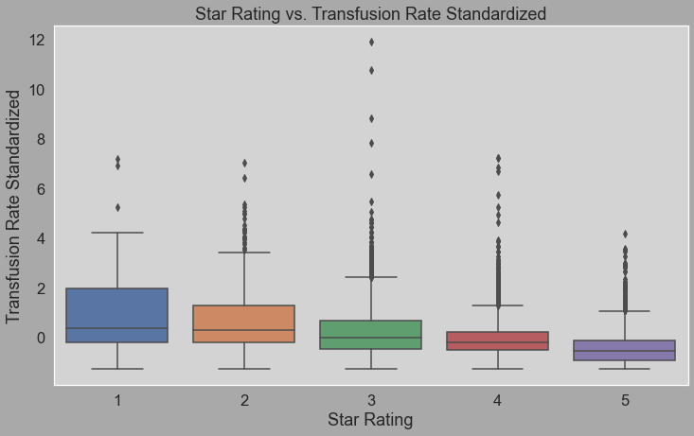
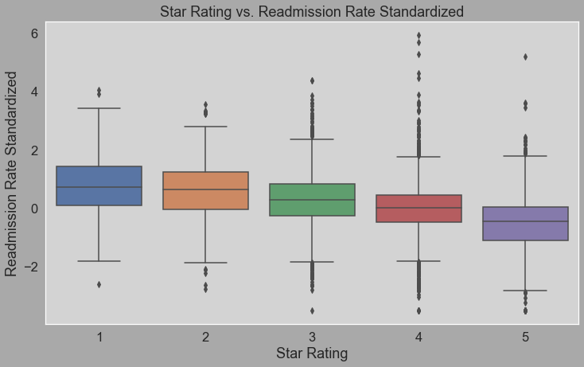
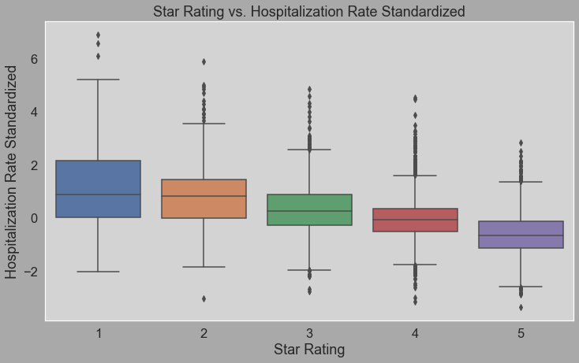
Narrower range = higher star rating
Multiple features show negative correlation with increased star rating
Notes:
In order to get high star rating need to have low mortality, transfusion rate, readmission and hospitalization
Possible to have low rate for some features but still get low star rating if others high
Ranges wider than blood measures meaning if some get bad scores in some features can still achieve high star rating

Slide 9
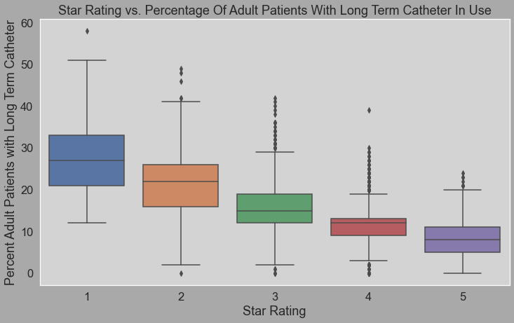
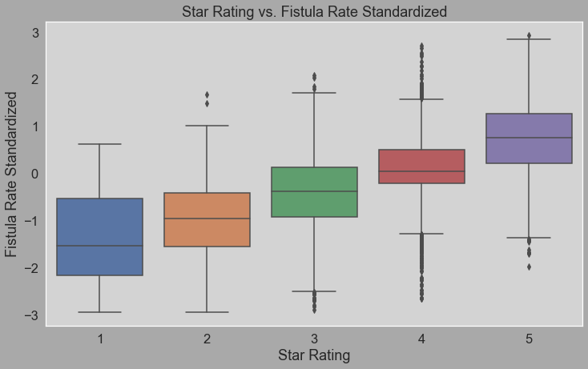
Relatively strong correlations
Fistulas & Catheters
Notes:
Fistula and catheters have relatively strong correlations with star rating indicating they are more importance features in determining star rating
Note: they have wide ranges meaning while they are important features other features still need to score well in order to achieve a high star rating

Slide 10
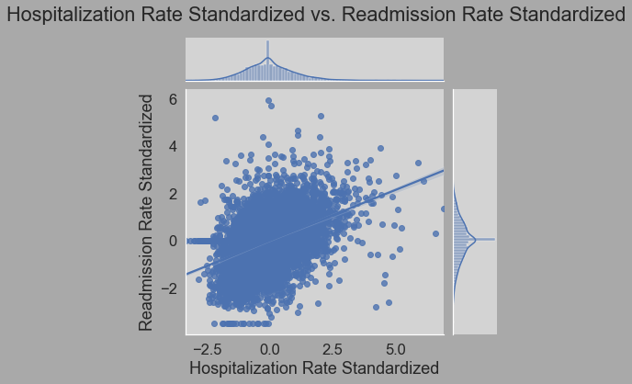
Hospitalization and readmission are positively correlated
May be a causing model to overfit
If in readmission already been in hospital

Slide 11
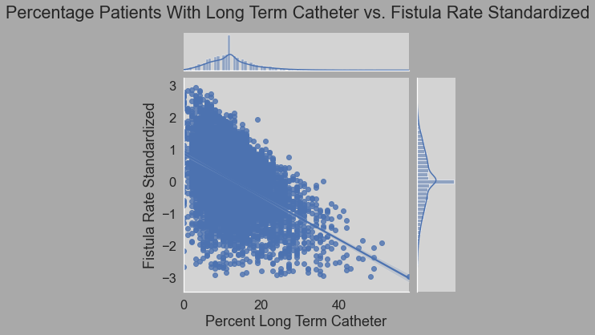
Catheter and fistula negatively correlated
May be a causing model to overfit
Patient typically only receives either a fistula or a catheter

Slide 12
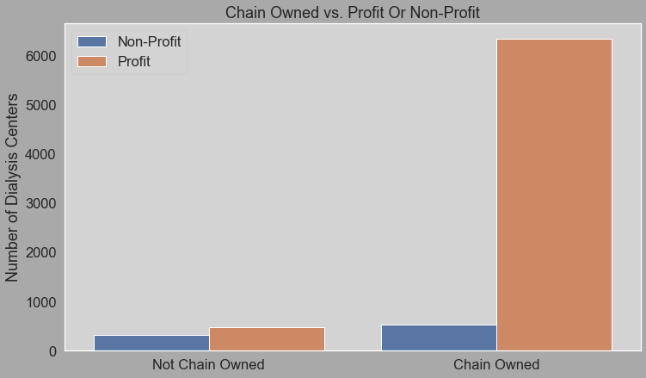
Data Skewed? Majority of centers for-profit, chain-owned
Notes:
Majority of dialysis centers in dataset are for-profit and chain owned
Is this skewing our results?

Slide 13
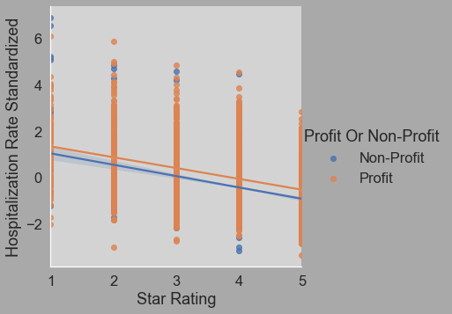
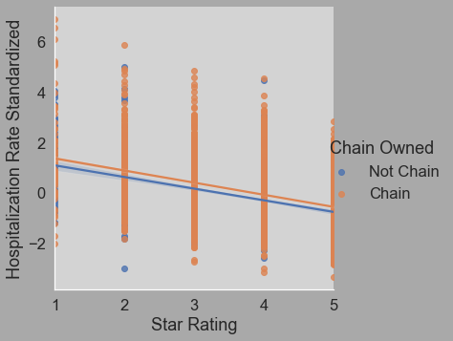
Large overlap between profit and chain statuses
Notes:
Seems we are ok. Using hospitalization rate as determining feature, we see a large overlap between centers that are either profit or non-profit and chain owned or not chain owned

Slide 14
Model Overview
Supervised learning: Star Rating label
Multiclass classification: 5 star classes
Imbalanced: Majority of centers have 3, 4, or 5 stars
Tools: Scikit-learn, GXBoost
Notes:
This dataset is labelled since we are looking for star ratings and therefore can used supervised learning
There are five star classed making the model multiclass
The labels are imbalanced with the majority of classes being 3, 4 or 5 stars
We will use scikit-learn and gxboost

Slide 15
Modeling Steps
Preprocessing
Hyperparameter Tuning
Build Model
Cross Validate
Label encoding
Standardize and remove outliers
Data split (75% train, 25% test)
Parameters and ranges
F1 score with micro-average
Randomized Search with 5 cv
Optimized parameters
Fit & predict model
Find runtime
Classification report
Run cross validation on optimized model
Repeat for each model
Notes:
Preprocessing
Set star rating as dependent variable
Set features to those defined in dialysis facility compare star program
Hyperparameter tuning
Search parameters for n_estimators, criterion, and max_depth
Use F1 score since classes are imbalanced
Used randomized search with 5 cross validation
Build model
Optimized parameters are 500 estimators, entropy and 12 depth
Take those parameters to fit and predict model
Also find the runtime
And print a classification report
Cross validate
Finally cross validate the optimized model
Repeat for each model

Slide 16
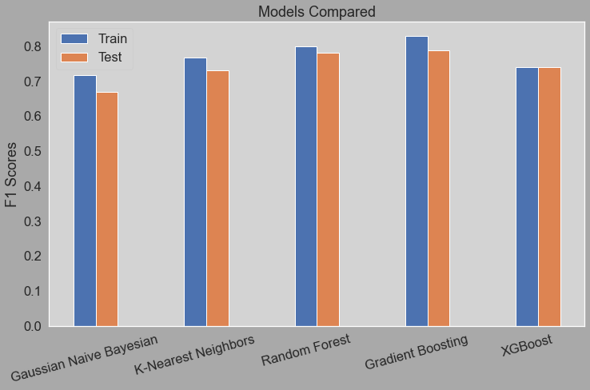
Model Performance
Random Forest and Gradient Boosting have similar scores
Random forest runs faster
Random Forest Best Model
Notes:
Classification Models Used
Gaussian Naive Bayesian
K-Nearest Neighbor
Random Forest
Gradient Boosting
XGBoost
Random Forest and Gradient Boosting have the highest F1 scores
0.802782
4.711022
Gradient Boosting
0.825009
0.764209
Random Forest runs faster than Gradient Boosting
Therefore decided to use Random Forest

Slide 17
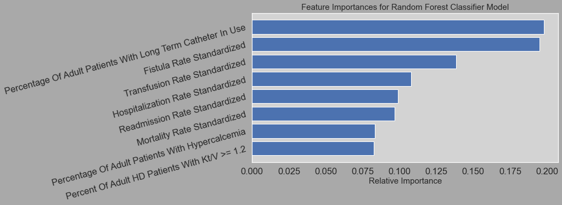
Feature Importance
Notes:
Long term catheter and fistula are the most important features
Hypercalcemia and Kt/V >= 1.2 are the least important

Slide 18
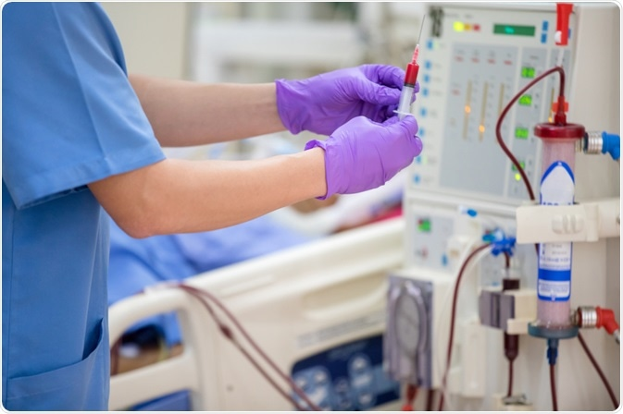
Constraints
Only patients treated at dialysis centers
Only centers registered by Medicare
Health factors unrelated to dialysis
Insufficient pediatric information
Waste removed via dialysis broad term
Overlap between health statistics
Notes:
Percentage of Waste Removed During Hemodialysis in Adults and Children & Percentage of Waste Removed in Adults During Peritoneal Dialysis are broad terms encompassing multiple features. In order to avoid overfitting, decided to use the features that at least moderately correlated (>= 0.3) with the dependent variable (star rating).

Slide 19

Ideas to Improve Model Performance
Further hyperparameter tuning
Find most important features in determining percent waste removed
Gather pediatric patient information
Directly link patient demographics to dialysis centers
Find dialysis center explained reasoning for star rating
Notes:
Further hyperparameter tuning, only a few features were hypertuned in order to save computation time
Percentage of Waste Removed During Hemodialysis in Adults and Children & Percentage of Waste Removed in Adults During Peritoneal Dialysis are broad terms encompassing multiple features. In order to avoid overfitting, only use the features that are at least moderately correlated (>= 0.3) with the dependent variable (star rating).
Also not enough information was available to include pediatric patients
We could also directly linked patient demographics to dialysis centers instead of working with percentages
Finally classifying why centers say they have the rating they do

Slide 20

Conclusions
Used 8 features (from star rating definition)
Ran 5 supervised, multiclass classifiers
Random Forest best model
75%/25% train/test split:
F1 test score = 0.802782
Runtime = 4.711022
Modeling can be improved with further tuning & research
Notes:
Used 8 features to define star rating:
Percent Of Adult HD Patients With Kt/V >= 1.2
Percentage Of Adult Patients With Hypercalcemia (Serum Calcium Greater Than 10.2 mg/dL)
Mortality Rate Standardized
Readmission Rate Standardized
Hospitalization Rate
Transfusion Rate
Fistula Rate
Percentage Of Adult Patients With Long Term Catheter In Use
Ran 5 supervised, multiclass classifiers
Gaussian Naive Bayesian
K-Nearest Neighbor
Random Forest
Gradient Boosting
XGBoost
Random Forest found to be the best model
Used a 75/25 train/test split to find a F1 test score of about 80%
And a runtime of 4.7 minutes
Modeling can be improved Further hyperparameter tuning
Find most important features in determining percent waste removed
Gather pediatric patient information
Directly link patient demographics to dialysis centers
Find dialysis center explained reasoning for star rating

